Slide 1

Best Digital Marketing Company in Coimbatore

Slide 2
DIGITAL MARKETING TRAINING IN TRAFFIC INTEGRATION
Traffic Integration provides 100% period of time, sensible Digital marketing Company in Coimbatore. Our Digital marketing course concentrates from basic level coaching to advanced level coaching. Our Digital marketing coaching is totally centered to urge placement in MNC in Coimbatore and certification on Digital marketing when completion of our course. Our team of Digital marketing trainer’s square measure Google certified professionals with additional period of time expertise in live projects.

Slide 3
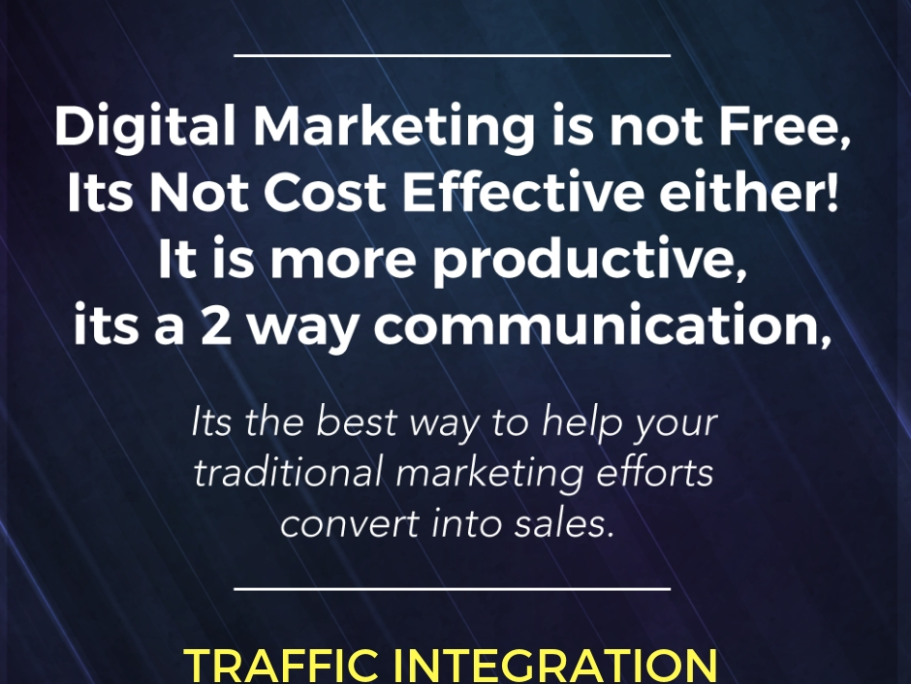
Traffic Integration- Digital marketing company
Our Training Institute is completely looking to offer this Digital Marketing training in various places in and around Coimbatore

Slide 4
Course Modules
Our Digital marketing Course covers associate Introduction to Digital marketing, Building a Digital Foundation , designing an internet website for on-line marketing , SEO, Building or Optimizing an internet website for on-line marketing , Content marketing , Search Engine Marketing , Social Media marketing , Blogging , on-line Advertising , Email marketing , on-line marketing strategy with various live sensible examples.

Slide 5
Lab Facility
Our Digital marketing coaching center is equipped with good surroundings to be told with all needed facilities. We have a tendency to guide our Digital marketing coaching students to be an authorized at finish of our course. Within the last six months timeframe we completed Digital marketing coaching for over 80+ students with glorious feedback and also the students getting placements in top MNC Companies.

Slide 6
Course Fee and Timings
Our Digital marketing coaching course fee is extremely nominal that anyone will pay in installment basis moreover. We have multiple category timings that suit everybody to learn in their own timings. Our Digital marketing coaching is regular in regular weekdays and weekends supported the scholar’s request.
We have a tendency to do have means Digital marketing coaching and on-line Digital marketing coaching with matched basis. We additionally provide Digital marketing coaching for Corporate Company; the workers of their company are edges with our coaching.

Slide 7
Contact us
Email - info@trafficintegration.com
Call - +(91) 979 180 4290
Address - 52/1, Kongu Nagar/ Ramanathapuram/ Coimbatore/ TN/ India.

